Slide 1
Applying K-Means Clustering to Photon Patterns for an Optimal Approach to Photon Density Estimation
MSci Thesis
Fadl Akkad - 799347

Slide 2
Introduction
Global illumination
Ray Tracing, Path Tracing
Photon Mapping – Density Estimation

Slide 3
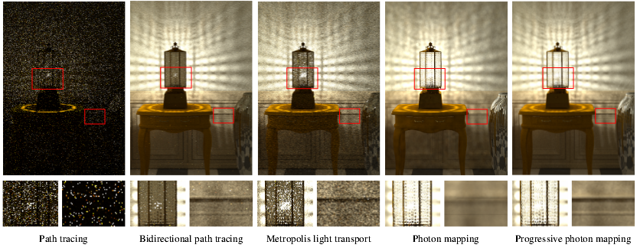
Motivation
Many innovations regarding photon mapping.
Progressive Photon Mapping (PPM)
Stochastic Progressive Photon Mapping(SPPM)
T Hachisuka, S Ogaki, and H.W Jensen. “Progressive Photon Mapping”.

Slide 4
Motivation
K-Means?
Alternative
Technicalities
Advantageous to density estimation

Slide 5
Related Work
Examination of Viable Global Illumination Methodologies
Monte Carlo Rendering
Evaluating diffuse paths with path tracing
Monte Carlo radiosity
Caustic forecasting
Evaluation of ‘K-Means’ and GPU performance
Scalable Interactive Global Illumination

Slide 6
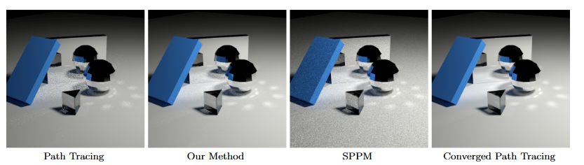
Related Work
Examination of Viable Global Illumination Methodologies
Progress made by Doidge et al. ”Mixing Monte Carlo and Progressive Rendering for Improved Global Illumination”

Slide 7
Related Work
Examination of Viable Global Illumination Methodologies
David Arthur and Sergei Vassilvitskii. “How Slow is the K-Means Method?”
C Benthin, I Wald, and P Slasallek. “A Scalable Approach to Global Illumination”.
B.C Budge, J.C Anderson, and K.I Joy. “Caustic Forecasting: Unbiased Estimation of Caustic Lighting for Global Illumination”.
H Dammertz, A Keller, and H.P.A Lensch. “Progressive Point-Light-Based Global Illumination”.
Ian C. Doidge, Mark W. Jones, and Benjamin Mora. “Mixing Monte Carlo and Progressive Rendering for Improved Global Illumination”.
Pascal Gautron et al. “Radiance Cache Splatting: A GPU Freindly Global Illumination Algorithm”.
E.P Lafortune and Y.D Willems. “Bi-Directional Path Tracing”.
E Veach and L.J Guibas. “Optimally Combining Sampling Techniques for Monte Carlo Rendering”.
Vincent Vivanloc et al. “Light Octree: Global Illumination Fast Reconstruction and Real Time Navigation”.
R Wang et al. “An Efficient GPU Based Approach for Interactive Global Illumination”.

Slide 8
Related Work
Innovations Regarding Progressive Stochastic Photon Mapping
Analysis of PPM SPPM
Metropolis Sampling
Hierarchical photon mapping
Progressive photon relaxation
Bias compensation for photon maps
Lighting reconstruction using density estimation techniques

Slide 9
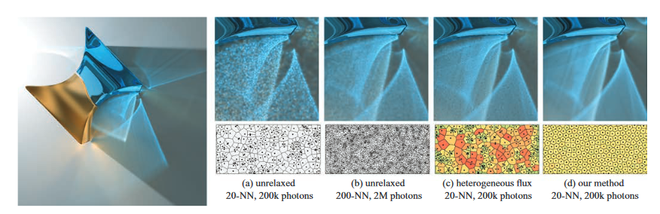
Related Work
Closer Inspection Regarding Photon Mapping and Density Estimation
Progress made by Spencer and Jones. ”Progressive Photon Relaxation”

Slide 10
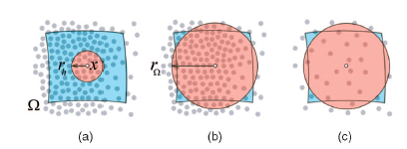
Related Work
Closer Inspection Regarding Photon Mapping and Density Estimation
Demonstration by Spencer and Jones of the more efficient uses of radiance estimates, with (c) being the result of purposeful photon categorisation. ”Hierarchical Photon Mapping”

Slide 11
Related Work
Innovations Regarding Progressive Stochastic Photon Mapping
Closer Inspection Regarding Photon Mapping and Density Estimation
J Chen, B Wang, and J.H Yong. “Improved Stochastic Progressive Photon Mapping with Metropolis Sampling”.
T Hachisuka and H.W Jensen. “Stochastic Progressive Photon Mapping”.
T Hachisuka and H.W Jensen. “Robust Adaptive Photon Tracing Using Photon Path Visibility”.
T Hachisuka, S Ogaki, and H.W Jensen. “Progressive Photon Mapping”.
H.W Jensen. “Global Illumination Using Photon Maps”.
Alexander Keller et al. “A Divide-and-Conquer Algorithm for Simultaneous Photon Map Queries”.
K Myszkowski. “Lighting Reconstruction Using Fast and Adaptive Density Estimation Techniques”.
R Schregle. “Bias Compensation for Photon Maps”.
P Shirley et al. “Global Illumination via Density-Estimation”.
B Spencer and M.W Jones. “Heirarchical Photon Mapping”.
B Spencer and M.W Jones. “Into the Blue: Better Caustics Through Photon Relaxations”.
B Spencer and M.W Jones. “Photon Parameterisation for Robust Relaxation Constraints”.
B Spencer and M.W Jones. “Progressive Photon Relaxation”.
B Walter. “Density Estimation Techniques for Global Illumination - phD Thesis”.

Slide 12
Research and Methodology
The Efficacy of K-Means Clustering for Density Estimation
K-Means clustering proves to be rewarding
Workable degree of flexibility
Dedicated to identifying patterns in densely populated samples

Slide 13
Research and Methodology
Algorithm Fundamentals
E. Forgy. “Cluster Analysis of Multivariate Data: Efficiency versus Interpretability of Classification”.
S.P. Lloyd. “Least Squares Quantization in PCM”.
J. A. Hartigan and M. A. Wong. “Algorithm AS 136: A K-Means Clustering Algorithm”.
J. MacQueen. Some Methods for Classification and Analysis of Multivariate Observations”.
G. Voronoi. “Nouvelles applications des parametres continus a la theorie des formes quadratiques”.

Slide 14
Research and Methodology
Collecting Photon Locations and Categories
Gather and Radiance Settings
Colour Categorisation
Iterative Passes

Slide 15
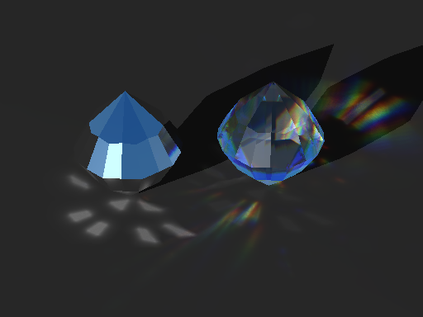
Sample Environments

Slide 16
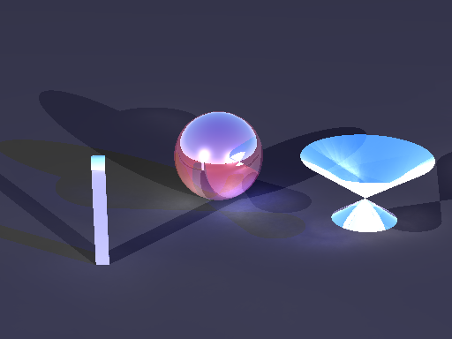
Sample Environments

Slide 17
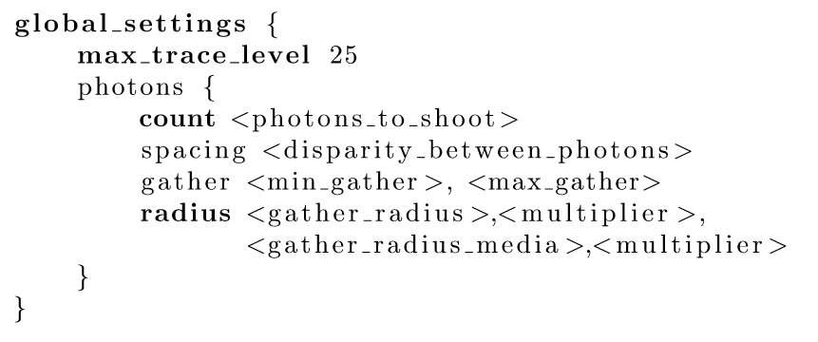
Querying Gather Data

Slide 18
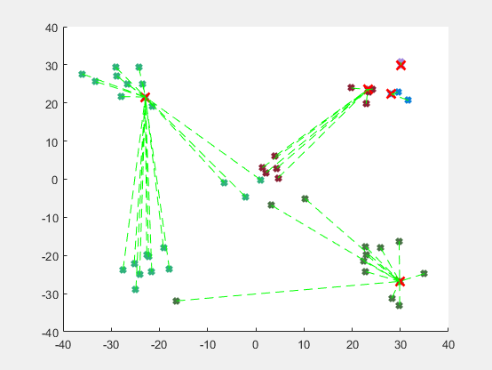
Constructing the K-Means Algorithm

Slide 19
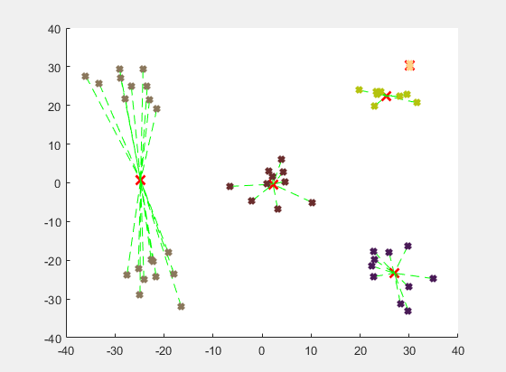
Constructing the K-Means Algorithm

Slide 20
Evaluation of Methodology
Requires further validation
May not provide the most accurate assortment of data samples
Area of improvement? K-D trees, collect samples more efficiently

Slide 21
Applying K-Means Clustering to Photon Patterns for an Optimal Approach to Photon Density Estimation
MSci Thesis
Fadl Akkad - 799347

